Slide 1
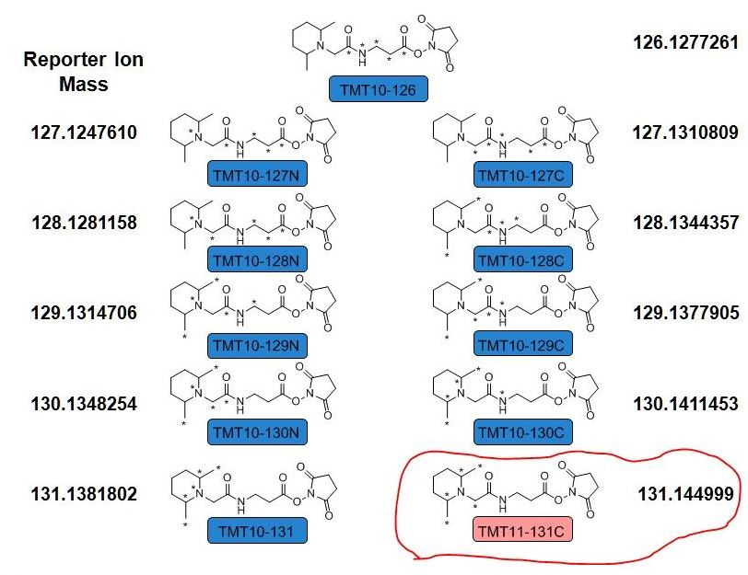
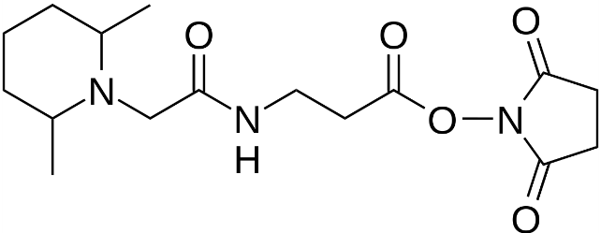
TMT-11 Isobaric Labeling Method
TMT-11
127N-126 = 0.9970349
Generic TMT structure
4C¹³ 1N¹⁵ (0C¹³ 0N¹⁵)
127C-127N = 0.0063199
HCD
4C¹³ 1N¹⁵ (0C¹³ 1N¹⁵)
4C¹³ 1N¹⁵ (1C¹³ 0N¹⁵)
128C-128N = 0.0063199
4C¹³ 1N¹⁵ (1C¹³ 1N¹⁵)
4C¹³ 1N¹⁵ (2C¹³ 0N¹⁵)
ETD
129C-129N = 0.0063199
4C¹³ 1N¹⁵ (2C¹³ 1N¹⁵)
4C¹³ 1N¹⁵ (3C¹³ 0N¹⁵)
Mass
Reporter
Mass
Normalizer
NH₂ Reactive
Group
130C-130N = 0.0063199
4C¹³ 1N¹⁵ (3C¹³ 1N¹⁵)
4C¹³ 1N¹⁵ (4C¹³ 0N¹⁵)
131C-131N = 0.0068188
4C¹³ 1N¹⁵ (4C¹³ 1N¹⁵)
5C¹³ 0N¹⁵ (5C¹³ 0N¹⁵)

